Slide 1
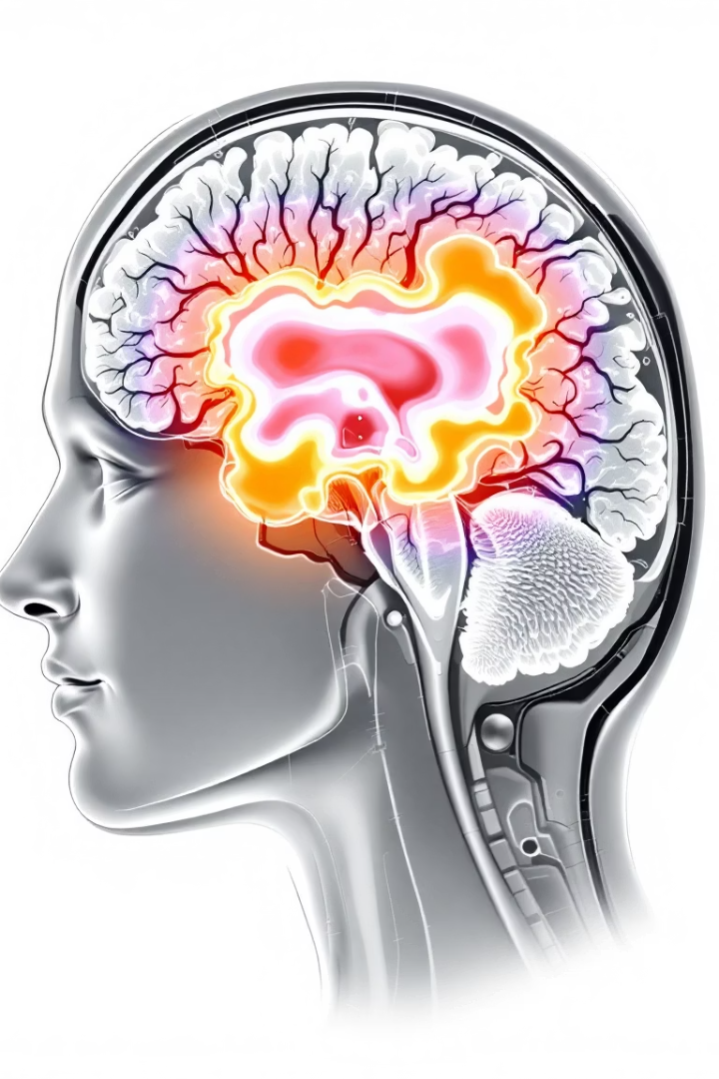

Brain Tumor Classification and Segmentation with MONAI & PyTorch
Presented by Shashank Jaiswal, 500109929 Pattern Recognition and Anomaly Detection

Slide 2
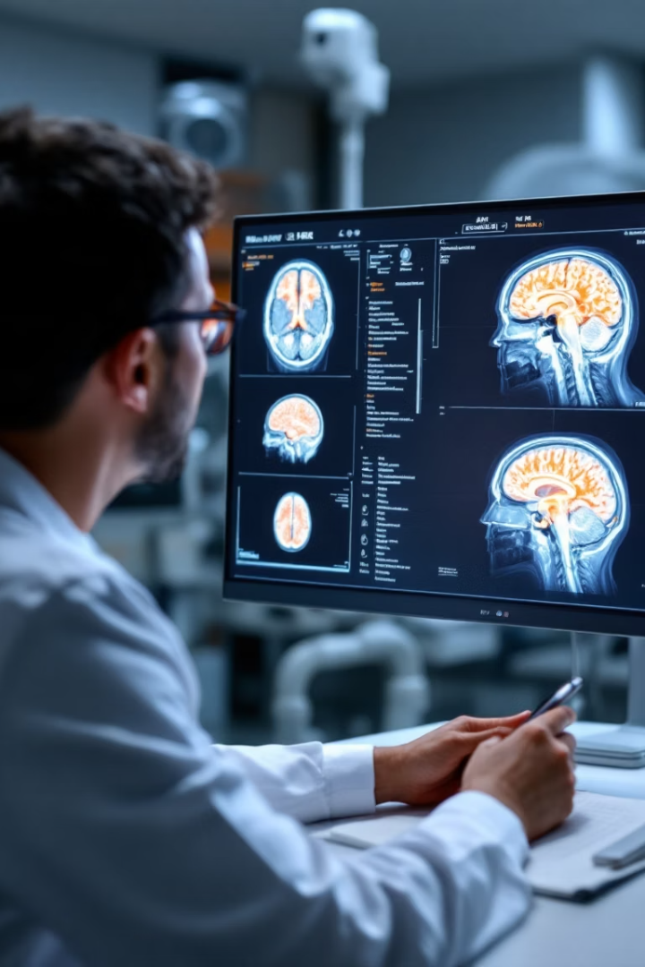
Introduction to the Project
Project focus
Goal
Deep learning segmentation of brain tumors
Automate detection to aid radiologists
Benefits
Higher accuracy and workflow efficiency

Slide 3
Motivation and Objective
Motivation
Main Objective
Manual segmentation is slow and error-prone
Develop robust segmentation model using MONAI U-Net
AI offers fast, reproducible, accurate results
Optimize for 3D medical imaging datasets

Slide 4
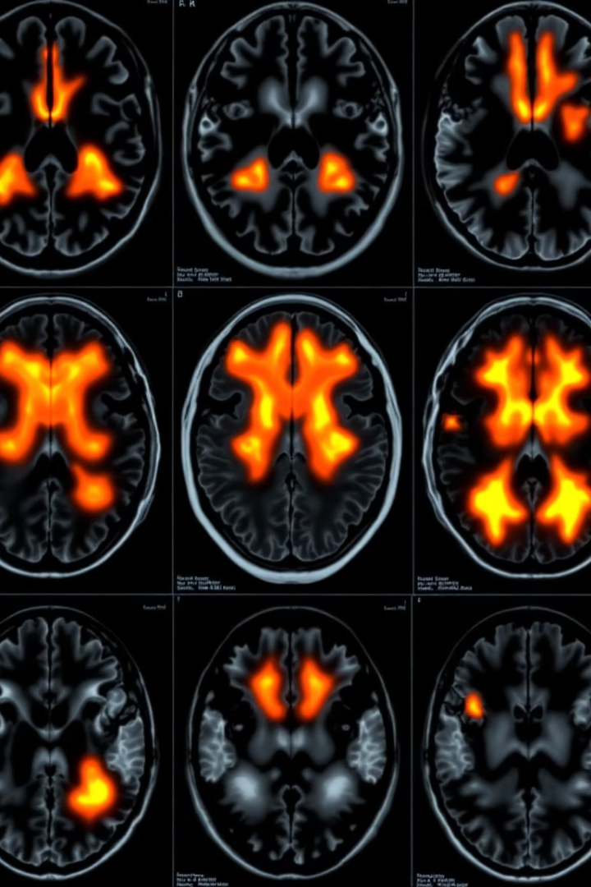
Problem in Medical Image Segmentation
Challenges
Data issues
High tumor variability in shape, size, location
Class imbalance and noisy MRI scans
Need
Precise, reproducible segmentation for diagnosis

Slide 5
Literature Review Insights
Reference Papers
Inferences
U-Net for medical image segmentation
U-Net yields consistent medical segmentation
MONAI's modular medical AI tools
Data augmentation boosts generalization
Studies on tumor core, whole tumor, enhancing tumor
MONAI enhances modular, medical-specific workflows

Slide 6

Application Areas of the Project
Medical Imaging
Brain MRI analysis for tumor detection
Clinical Support
Assists radiologists in tumor characterization
Education
Teaching tool for radiology students
Research
Framework for advanced medical AI innovations

Slide 7
Dataset and Input Format Details
Dataset Used
Label Classes
BraTS: Brain Tumor Segmentation dataset
1: Edema
Format: NIfTI images (.nii.gz)
2: Enhancing tumor
3: Necrotic core
Multi-channel masks combining labels to TC, WT, ET

Slide 8
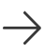
Technical Framework and Concepts
Frameworks
Architecture
Preprocessing
MONAI and PyTorch deep learning
Encoder, bottleneck, decoder with skip connections
Normalization, spacing, data augmentation
Augmentations
Loss Functions
Random cropping, flipping, intensity shifts
Dice loss and cross-entropy loss

Slide 9
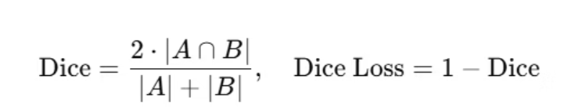
Dice Loss in Medical Image Segmentation
Dice Loss in Medical Image Segmentation
Definition: Dice Loss is based on the Dice Similarity Coefficient (DSC), measuring the overlap between predicted and actual segmentation masks.
Formula:
Why Use Dice Loss?
Excellent for imbalanced data (e.g., small tumors vs large background)
Focuses on region of interest, unlike Cross-Entropy
Encourages better boundary accuracy
In MONAI (Multiclass Segmentation):
from monai.losses import DiceLoss loss_function = DiceLoss(to_onehot_y=True, softmax=True, include_background=False)

Slide 10





Training and Evaluation Setup
Environment
CUDA-enabled PyTorch with MONAI integration
GPU Check
torch.cuda.is_available() validation
Training Pipeline
DataLoader, custom transforms, batch size 1
Validation
Separate Dataset for evaluation

Slide 11
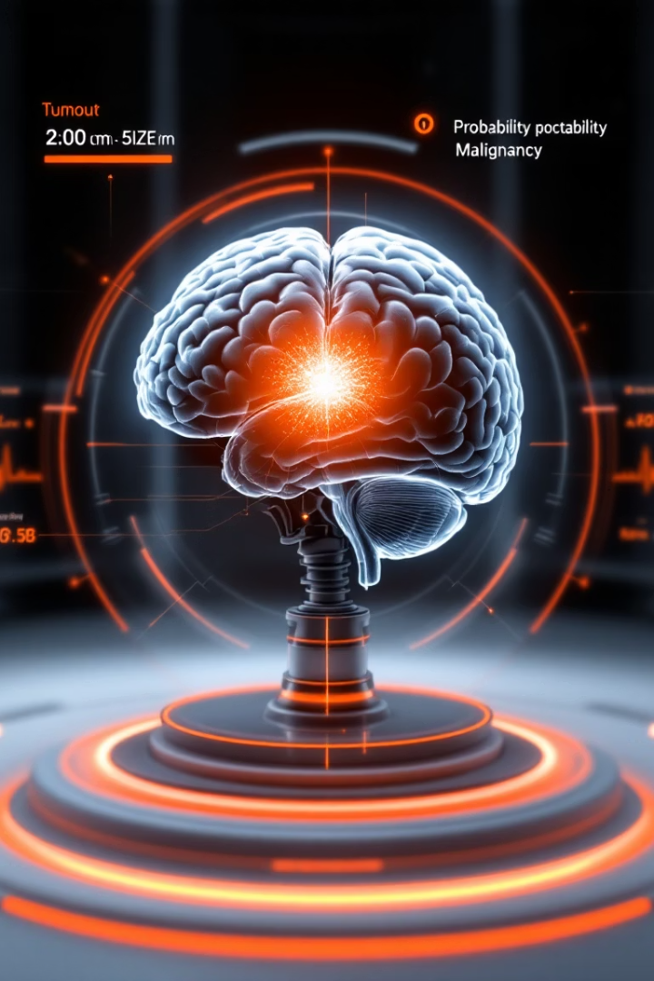
Summary and Next Steps
Achieved
Accurate 3D tumor segmentation using MONAI U-Net
Potential
Clinical assistance and educational uses
Next Steps
Enhance model robustness and speed
Future Work
Expand dataset and multi-modal integration

